Slide 1

A.C.M.E.:
Automated Collection and Manipulation of Email
Ryan Peters
Faculty Advisor: Prof. Bill Erdly
Sponsor: Dr. Luke Marney
Notes:
Welcome, and thank you for taking the time to learn more about – A.C.M.E: The automated collection and manipulation of email project.
By me :P Ryan Peters
With input and guidance by my faculty advisor, Prof. Bill Erdly and my project’s sponsor/primary stakeholder Dr. Luke Marney.

Slide 2
Introduction: Motivation
“Email management consumes significant effort from senders and recipients. Some of this work might be automatable.” - (Park, Zhang, Murray, and Karger. 2019)
“It is estimated that 269 billion emails were sent…per day in 2017 [26] …workers tend to spend up to 28% of their time reading and answering email…” - (Sarrafzadeh, Awadallah, Lin, Lee, Shokouhi, and Dumais. 2019)
The core principle of maintaining a strong professional, and collaborative, network is being able to emphasize the human connection elements in each interaction.
For full citations see slide titled ‘Citations’ at the end of presentation.
Notes:
Project background:
The original objective of this project was to create an open-source tool that could perform automated classification on messages in a user’s email inbox. E.G. determining if a message required the user to provide some actionable service, or if it was a request for information.
But as Dr. Marney and I discussed how to structure the project, while also researching existing tools for email analysis, we realized that simply building the support and preprocessing tools would require a non-trivial effort. So the project shifted focus from the more “sexy” sounding goal of automated classification, to the more realistic goal of technical abstraction.
This is where the contents of this slide tie in.
The proverbial days of the lone mad hermit learning the secrets of transmuting stone into gold are gone. All society impacting work going forward will be done by ever larger and more complex teams experts and specialists. This implicitly demands that the volumes of communication and exchange of information must also increase.

Slide 3
Introduction: Stakeholder Specifications
Must be 100% open source. Empower user to create custom solutions to new problems/applications.
No key dependencies on third-party libraries that use closed source code.
This ensures access to community driven solutions, and independent control over the project’s capability to adhere to possibly unique security requirements.
Ensures secured access to proprietary data in lab settings with limited-to-zero external network access.
Must be modular, with a linear execution sequence through project sub-modules.
Ensures easy modification to program flow and hot-swapping of alternate modules.
Should provide a minimal viable CLI
Allows for easy integration into scripted server creation and/or Docker containers
Leave complex/specialized interfaces for later development by user community.
Notes:
Leave the “cool” and “fun” stuff for the user community, this is the base toolset upon which they can build
Note: Accepts inherent loss of potential performance optimizations via per-email parallel pipelining.
Ensures secured access to proprietary data in lab settings with limited-to-zero external network access.
Get project code to your desired operational state, clone it to your thumb drive and set up your private network,
complete with custom internal mail server, and run your custom data extraction/analysis/classification tools in that setting.
The project’s sponsor and primary stakeholder, Dr. Luke Marney,

Slide 4


Help people invest their time and energy into new ideas and stronger human connections by separating and opening the computational tools to analyze their inbox.
Introduction: End Goal
Go from this:
To this:
Photo from:
https://www.craftyourcontent.com/wp-content/uploads/2017/05/The-Future-of-Writing-With-Robots-1024x379.png
Photo from:
https://www.shutterstock.com/image-photo/close-african-business-man-hands-working-1460065946
Notes:
JUST READ THE SLIDE
Humans be Human:
An often-overlooked key to effective collaboration and successful industry networking is to maintain focus on the human element of an interaction.
No one can be an expert at everything.
necessity is the mother of innovation
Processing the objective purpose of communications at the pace of modern work life is a non-trivial task.
You must assess not only what people are asking of you, but if you can even provide what they seek.
you must make sure you don’t overlook any corollary requests and secondary details.
it can often result in people losing sight of the human purpose of the interaction.
Collaboration
Relief from problems outside of their skill domain
Simple guidance/insight
Etc.

Slide 5
Help people invest their time and energy into new ideas and stronger human connections by separating and opening the computational tools to analyze their inbox.
Introduction: End Goal
Let Humans be Human:
Give people the tools needed to reduce time spent extracting details from their email, so more time can be spent focusing on the interaction with the person at the other end of the message.
Notes:
JUST READ THE SLIDE
Humans be Human: As the volume of emails demanding
An often-overlooked key to effective collaboration and successful industry networking is to maintain focus on the human element of an interaction.
No one can be an expert at everything.
necessity is the mother of innovation
Processing the objective purpose of communications at the pace of modern work life is a non-trivial task.
You must assess not only what people are asking of you, but if you can even provide what they seek.
you must make sure you don’t overlook any corollary requests and secondary details.
it can often result in people losing sight of the human purpose of the interaction.
Collaboration
Relief from problems outside of their skill domain
Simple guidance/insight
Etc.

Slide 6
Methods
Ok, but how? Conceptual Components. Core Design Philosophy. Tools & Technologies.

Slide 7
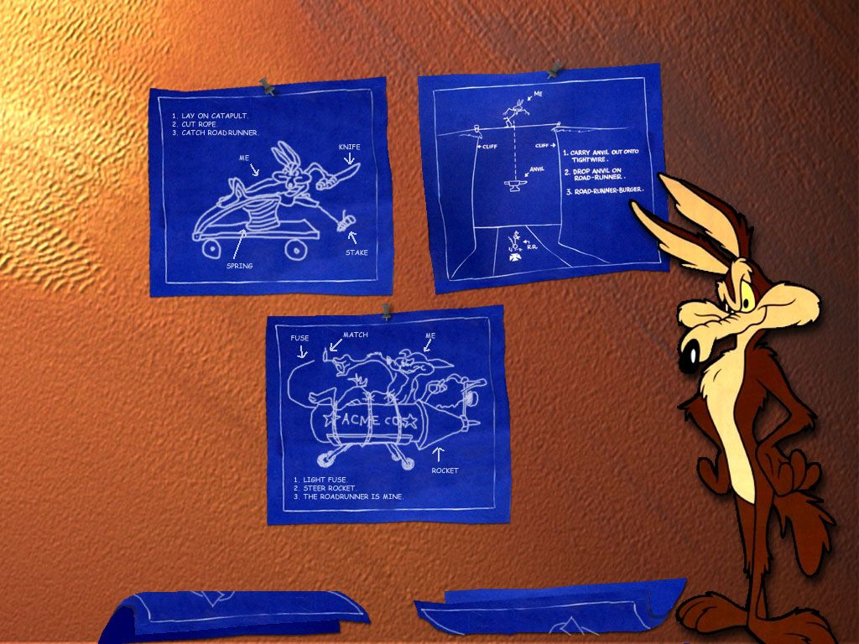
Methods
Ok, but how? Conceptual Components. Core Design Philosophy. Tools & Technologies.

Slide 8

Methods: Ok, but how?
TL;DR:
Abstract away the more nuanced technical details surrounding programmatic access to, and processing of, statistical/structural information encoded in your own email!
We built code base that allows those with a non-CS background to easily:
Collect email messages from an imap mail server
Convert those messages into raw text strings with various degrees of meta-data attached
Extract some initial statistical data from the exposed raw text.
Notes:
Help people break away from having to invest hours of their day trying to leverage past accomplishments, freeing them to put their time and energy into new ideas, stronger connections, or simply that all too neglected “me” time.
Be fluid, adaptive, modular:
There are many steps along the path to being able to perform statistical and structural analysis on the emails in your inbox. Not all the steps for person A may be necessary for person B, so we built each discrete step as a stand-alone module with well defined input/output specifications.

Slide 9
Methods: Conceptual Components
Collect emails and cache in local storage
Extract data from emails
General data preprocessing for linguistic analysis.
Data analysis
Notes:
The not so ugly slide!! When the project started, I had initially planned to

Slide 10

Methods: Conceptual Components
Collect emails and cache in local storage
How do we access the emails messages?
imap, or pop3?
What should be the storage medium?
Basic files managed with OS filesystem, or dedicated DB like SQLite/MySQL?
Extract data from emails
Message body
Handle translation of character encoding to UTF-8 (beware the /u2014, /u2018, /u2019)
Meta-data
sender, recipient, date recieved, related message ids, etc.
General data preprocessing for linguistic analysis.
Highly dependent upon chosen form of analysis that will follow
Data analysis
The “sexy” part
could be structured speech-act-theory decomposition, ml, or statistical analysis…
Notes:
The ugly slide!!! These are the sorts of questions I asked myself, and the resulting core concepts I arrived at, as I was planning the project out.
I don’t intend for anyone to actually parse and retain any of the information of this slide right now. But I do anticipate one or two questions along these lines to come up by the end of the presentation. At that time we can come back to this slide and “go deep” if you wish ;)

Slide 11
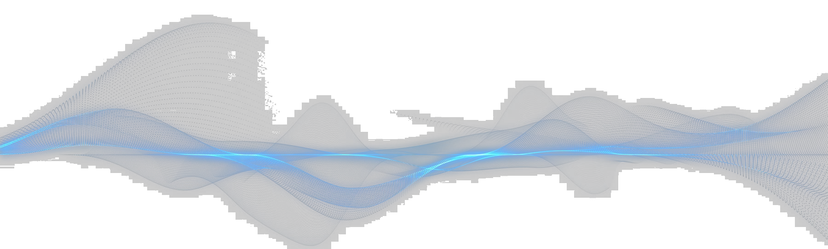
Methods: Core Design Philosophy
Be fluid, be adaptive, be modular
Provide complete access to source code. Thus, empowering individuals to address and solve their own unique concerns and needs.

Slide 12
Methods: Tools and Technologies
Development tools:
Python 3.9 and libraries:
NLTK -- Natural Language Processing tools.
SQLite -- SQL bindings wrapper for database implementation in Python.
Doit -- Multi-stage task automation package that orchestrates the automated execution of the project’s sub-modules.
Pandas -- Data exploration package used in diagnostic evaluation of word counts and NLP tools as project is developed.
Numpy -- Efficient data containers and optimized data manipulation algorithms.
Numba -- JIT compilation of arbitrary python code to significantly faster C++ representations.
* Full text for links can be found at end of presentation.

Slide 13
Results Project Component Breakdown
Project Generated DB schema
Notes:
Red block:
This preserves imap protocol RFC822 specified “envelope” structure for ease of access should downloader module be extracted and used in a separate project.
Green block:
Exposes header meta-data as a dictionary, and the message body as a string;

Slide 14
Results: Project Component Breakdown
Three primary modules
Notes:
Red block:
This preserves imap protocol RFC822 specified “envelope” structure for ease of access should downloader module be extracted and used in a separate project.
Green block:
Exposes header meta-data as a dictionary, and the message body as a string;

Slide 15
Results: Project Component Breakdown
Three primary modules
Data Collection
Collect Email from imap server and cache to disk using SQLite DB;
Load email envelopes from disk and construct custom python dataclass objects for each email;
Cache these dataclass objects to disk as a separate SQLite DB
Load message bodies from disk and apply lemmatization/stop-word filtration before producing statistical word count data;
Cache lemma and statistical data to disk in another new SQLite DB.
Notes:
Red block:
This preserves imap protocol RFC822 specified “envelope” structure for ease of access should downloader module be extracted and used in a separate project.
Green block:
Exposes header meta-data as a dictionary, and the message body as a string;

Slide 16
Results: Project Component Breakdown
Three primary modules
Data Collection
Collect Email from imap server and cache to disk using SQLite DB;
imap host
Download and generate unique ID
Sqlite3_email.db
Notes:
Red block:
This preserves imap protocol RFC822 specified “envelope” structure for ease of access should downloader module be extracted and used in a separate project.
Green block:
Exposes header meta-data as a dictionary, and the message body as a string;

Slide 17
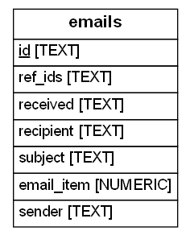
Results: Project Component Breakdown
Three primary modules
Data Collection
Collect Email from imap server and cache to disk using SQLite DB;
imap host
Download and generate unique ID
Sqlite3_email.db
Notes:
Red block:
This preserves imap protocol RFC822 specified “envelope” structure for ease of access should downloader module be extracted and used in a separate project.
Green block:
Exposes header meta-data as a dictionary, and the message body as a string;

Slide 18
Results: Project Component Breakdown
Three primary modules
Parsing imap structure, data cleaning, message formatting
Collect Email from imap server and cache to disk using SQLite DB;
Load email envelopes from disk and construct custom python dataclass objects for each email;
Cache these dataclass objects to disk as a separate SQLite DB
Load message bodies from disk and apply lemmatization/stop-word filtration before producing statistical word count data;
Cache lemma and statistical data to disk in another new SQLite DB.
Notes:
Red block:
This preserves imap protocol RFC822 specified “envelope” structure for ease of access should downloader module be extracted and used in a separate project.
Green block:
Exposes header meta-data as a dictionary, and the message body as a string;

Slide 19
Results: Project Component Breakdown
Three primary modules
Parsing imap structure, data cleaning, message formatting
Collect Email from imap server and cache to disk using SQLite DB;
Load email envelopes from disk and construct custom python dataclass objects for each email;
Cache these dataclass objects to disk as a separate SQLite DB
Load message bodies from disk and apply lemmatization/stop-word filtration before producing statistical word count data;
Cache lemma and statistical data to disk in another new SQLite DB.
Sqlite3_email.db
Load imap envelope to memory
Separate header-meta-data from message string
Sqlite3_body.db
Notes:
Red block:
This preserves imap protocol RFC822 specified “envelope” structure for ease of access should downloader module be extracted and used in a separate project.
Green block:
Exposes header meta-data as a dictionary, and the message body as a string;

Slide 20
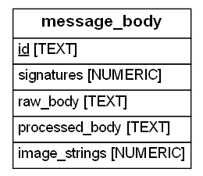
Results: Project Component Breakdown
Three primary modules
Parsing imap structure, data cleaning, message formatting
Collect Email from imap server and cache to disk using SQLite DB;
Load email envelopes from disk and construct custom python dataclass objects for each email;
Cache these dataclass objects to disk as a separate SQLite DB
Load message bodies from disk and apply lemmatization/stop-word filtration before producing statistical word count data;
Cache lemma and statistical data to disk in another new SQLite DB.
Sqlite3_email.db
Load imap envelope to memory
Separate header-meta-data from message string
Sqlite3_body.db
Notes:
Red block:
This preserves imap protocol RFC822 specified “envelope” structure for ease of access should downloader module be extracted and used in a separate project.
Green block:
Exposes header meta-data as a dictionary, and the message body as a string;

Slide 21
Results: Project Component Breakdown
Three primary modules
Message lemmatization, statistical pre-processing
Collect Email from imap server and cache to disk using SQLite DB;
Load email envelopes from disk and construct custom python dataclass objects for each email;
Cache these dataclass objects to disk as a separate SQLite DB
Load message bodies from disk and apply lemmatization/stop-word filtration before producing statistical word count data;
Cache lemma and statistical data to disk in another new SQLite DB.
Notes:
Red block:
This preserves imap protocol RFC822 specified “envelope” structure for ease of access should downloader module be extracted and used in a separate project.
Green block:
Exposes header meta-data as a dictionary, and the message body as a string;
Blue block:
…

Slide 22
Results: Project Component Breakdown
Three primary modules
Message lemmatization, statistical pre-processing
Collect Email from imap server and cache to disk using SQLite DB;
Load email envelopes from disk and construct custom python dataclass objects for each email;
Cache these dataclass objects to disk as a separate SQLite DB
Load message bodies from disk and apply lemmatization/stop-word filtration before producing statistical word count data;
Cache lemma and statistical data to disk in another new SQLite DB.
Sqlite3_body.db
Load message string to memory
Apply lemmatization
Build NLTK.WordBag
Remove stop-words
Sqlite3_lemma.db
Notes:
Red block:
This preserves imap protocol RFC822 specified “envelope” structure for ease of access should downloader module be extracted and used in a separate project.
Green block:
Exposes header meta-data as a dictionary, and the message body as a string;
Blue block:
…

Slide 23
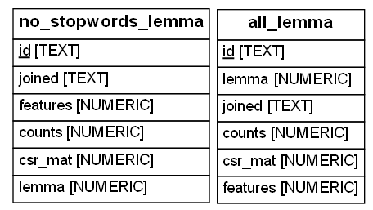
Results: Project Component Breakdown
Three primary modules
Message lemmatization, statistical pre-processing
Collect Email from imap server and cache to disk using SQLite DB;
Load email envelopes from disk and construct custom python dataclass objects for each email;
Cache these dataclass objects to disk as a separate SQLite DB
Load message bodies from disk and apply lemmatization/stop-word filtration before producing statistical word count data;
Cache lemma and statistical data to disk in another new SQLite DB.
Sqlite3_body.db
Load message string to memory
Apply lemmatization
Build NLTK.WordBag
Remove stop-words
Sqlite3_lemma.db
Notes:
Red block:
This preserves imap protocol RFC822 specified “envelope” structure for ease of access should downloader module be extracted and used in a separate project.
Green block:
Exposes header meta-data as a dictionary, and the message body as a string;
Blue block:
…

Slide 24
Results: Project generated DB schema
Notes:
Things to add to slide:
Say that it’s in R
We can now say we classified emails as well.

Slide 25
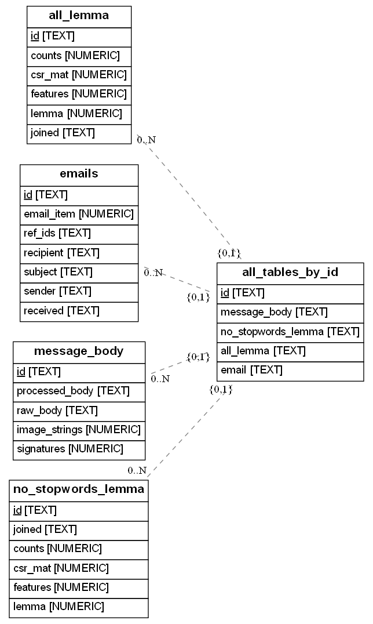
Results: Project generated DB schema
An example of the programmatically generated DB ERD for a contrived DB composed from the 3 descrete databases shown in the previous slide.
Notes:
Things to add to slide:
Say that it’s in R
We can now say we classified emails as well.

Slide 26
Conclusion
Helpful Courses
In its Current State
Next Steps
Future Research Possibilities
Notes:
Luke’s “code scribbles” produced these figures
Data science is an interdisciplinary field that uses scientific methods, processes, algorithms and systems to extract knowledge and insights from structured and unstructured data
Things to add to slide:
since stakeholder is a statistical chemist, he does research on data clustering
So, we are essentially, trying to expose data available in one’s own inbox so that he, and people like him, can apply those analytic skills to that data.
Say that it’s in R
We can now say we classified emails as well.
Paper shared pertains to genetics “micro-expressions” data – look up what micro-expressions are.

Slide 27
Conclusion: Helpful courses
CSS 475: Database Systems
Helpful for evaluating and selecting appropriate database platform
CSS 342-343: Data Structures, Algorithms, And Discrete Mathematics
Optimization of data management structures
CSS 432 Network Design And Programming
For better understanding of how to properly secure data transmission during email collection and for securely exposing phase specific DBs in user customized program flow.
CSS 360 Software Engineering
Guided my approach to framing the objective and how I would approach the iterative development process.

Slide 28
Conclusion: In its Current State
In this project we built:
4 modules:
Email collection from an imap host inbox.
Conversion from imap envelope structure into header-meta-data and the message string.
Basic statistical and structural generation from message strings.
Lemmatization
Stop-word filtering
Word-counts
Utility tools and functions used by all three of the preceding modules.
Custom logging tools for detailed and visually clear diagnostic output
Notes:
This should be a bulleted list of what was done, what the next steps look like,
(maybe interesting points along the way)
and finally, a thank you!
Thank Prof. Erdly, Dr. Marney, the UWB CSS dept, Kiera, and anyone else
that conceivably contributed.

Slide 29
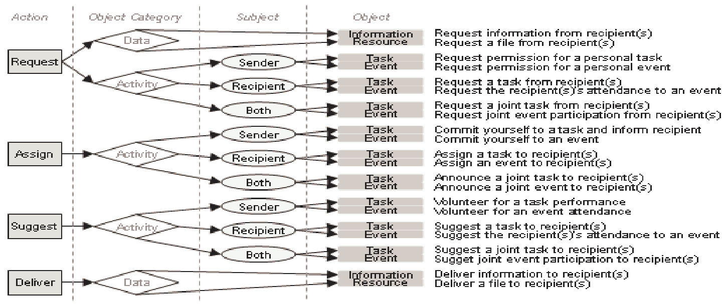
Conclusion: Next Steps
Improve structural analysis toolset
Specifically, implement the Speech-Act-Theory strategy described in Classifying Action Items for Semantic Email.---------->
Update CLI to use curl and possibly blast
Update GitHub repo to better accommodate extracting sub-modules
Notes:
This should be a bulleted list of what was done, what the next steps look like,
(maybe interesting points along the way)
and finally, a thank you!
Thank Prof. Erdly, Dr. Marney, the UWB CSS dept, Kiera, and anyone else
that conceivably contributed.

Slide 30
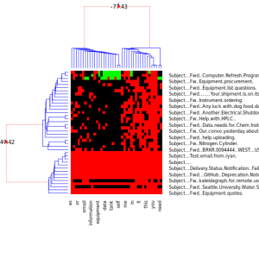
Conclusion: Future research possibilities
Data science is an interdisciplinary field that uses scientific methods, processes, algorithms and systems to extract knowledge and insights from structured and unstructured data
Numerical and Categorical Metadata
Emails and Words
Chemometrics, genomic, proteomic,
and metabolomic clustering tools
Meaningful information about physical processes
Future Research Question: Can we use the same tools?
Bayesian Hierarchical clustering (BHC)
Notes:
Luke’s “code scribbles” produced these figures
Data science is an interdisciplinary field that uses scientific methods, processes, algorithms and systems to extract knowledge and insights from structured and unstructured data
Things to add to slide:
since stakeholder is a statistical chemist, he does research on data clustering
So, we are essentially, trying to expose data available in one’s own inbox so that he, and people like him, can apply those analytic skills to that data.
Say that it’s in R
We can now say we classified emails as well.
Paper shared pertains to genetics “micro-expressions” data – look up what micro-expressions are.

Slide 31
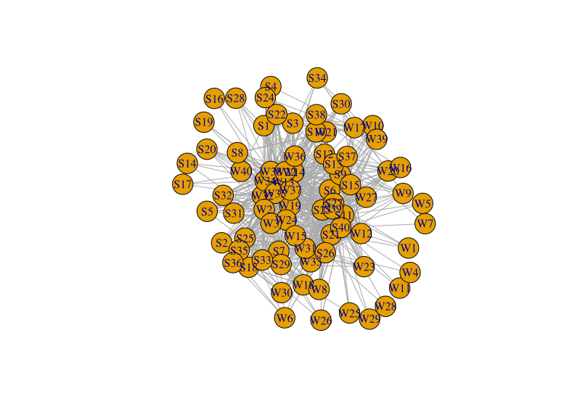
Conclusion: Future research possibilities
Data science is an interdisciplinary field that uses scientific methods, processes, algorithms and systems to extract knowledge and insights from structured and unstructured data
Numerical and Categorical Metadata
Emails and Words
Chemometrics, genomic, proteomic,
and metabolomic clustering tools
Meaningful information about physical processes
Future Research Question: Can we use the same tools?
Relational network W = Words ; S = Subject Header
Notes:
Luke’s “code scribbles” produced these figures
Data science is an interdisciplinary field that uses scientific methods, processes, algorithms and systems to extract knowledge and insights from structured and unstructured data
used a simple Kamada Kawai spring energy minimum layout (a default option with igraph package in R) and the weights of the edges are defined by the counts of a word appearing in the respective emails

Slide 32
Thank you
Huge thanks go out to:
Prof. Bill Erdly for being my faculty advisor on this project.
Dr. Luke Marney for being the project’s sponsor and primary stake holder.
The UWB CSS dept. faculty and staff for providing the education that allowed me to be here today.
Kiera Peters for being greatest moral supporter throughout my college career as well as this project.
Notes:
This should be a bulleted list of what was done, what the next steps look like,
(maybe interesting points along the way)
and finally, a thank you!
Thank Prof. Erdly, Dr. Marney, the UWB CSS dept, Kiera, and anyone else
that conceivably contributed.

Slide 33
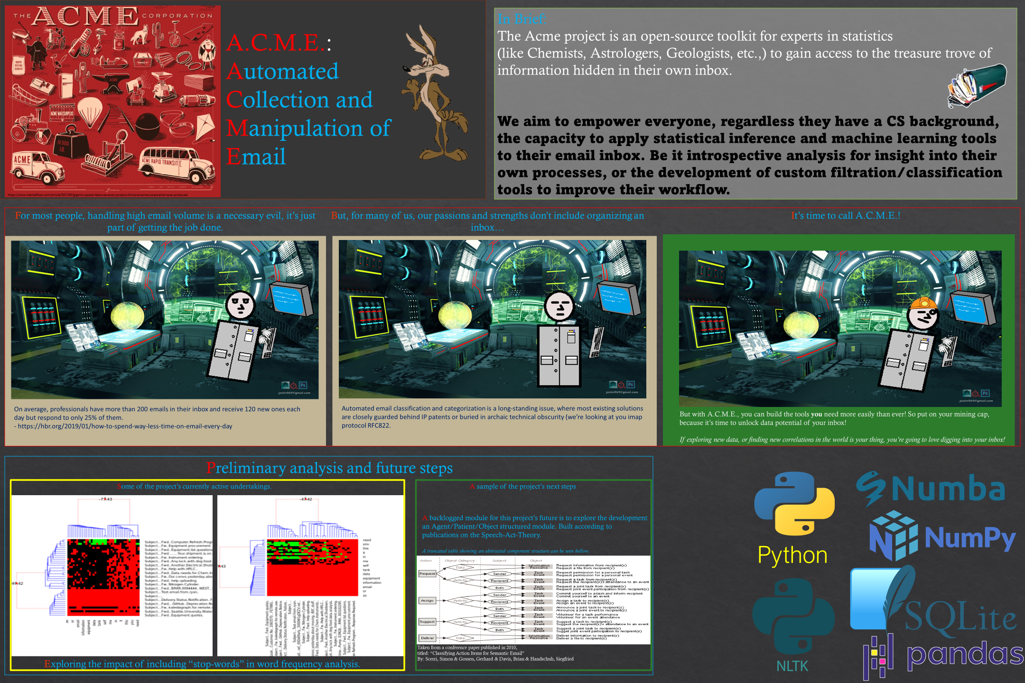

Slide 34
Citations
Soya Park, Amy X. Zhang, Luke S. Murray, and David R. Karger. 2019.
Opportunities for Automating Email Processing: A Need-Finding Study.
Proceedings of the 2019 CHI Conference on Human Factors in Computing Systems.
Association for Computing Machinery, New York, NY, USA, Paper 374, 1–12.
DOI: https://doi.org/10.1145/3290605.3300604
Bahareh Sarrafzadeh, Ahmed Hassan Awadallah, Christopher H. Lin, Chia-Jung Lee, Milad Shokouhi, and Susan T. Dumais. 2019.
Characterizing and Predicting Email Deferral Behavior.
Proceedings of the Twelfth ACM International Conference on Web Search and Data Mining WSDM ‘19.
Association for Computing Machinery, New York, NY, USA, 627–635.
DOI: https://doi.org/10.1145/3289600.3291028
Scerri, Simon & Gossen, Gerhard & Davis, Brian & Handschuh, Siegfried.
2010.
Classifying Action Items for Semantic Email.
Retrieved from https://www.researchgate.net/publication/220746717_Classifying_Action_Items_for_Semantic_Email
Retrieved on March 20, 2021

Slide 35
Full link addresses
NLTK: Natural Language Toolkit for Python https://www.nltk.org/
SQLite https://www.sqlite.org/index.html
Doit https://pydoit.org/
Pandas https://pandas.pydata.org/
Numpy https://numpy.org/doc/stable/user/whatisnumpy.html
Numba https://numba.pydata.org
cURL https://curl.se/
Blast https://github.com/mosuka/blast

Slide 36
Existing TOOLs sharing our objectives
Melusine: An open source tool for performing automated classification of email messages.
https://github.com/MAIF/melusine/blob/master/melusine/models/attention_model.py
Notes:
We are working towards building a tool that lets a user get into the nuts and bolts of the automation, not an end product that just does it all for them.

Slide 37
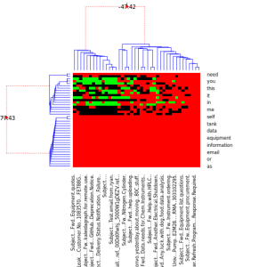
Email Classification
Bayesian Hierarchical clustering (BHC)
Notes:
Things to add to slide:
Say that it’s in R
We can now say we classified emails as well.

Slide 38
What ARE Tasks
“doit is all about automating task dependency management and execution.
Tasks can execute external shell commands/scripts or python functions (actually any callable).
So, a task can be anything you can code :)”
From: https://pydoit.org/tasks.html

Slide 39
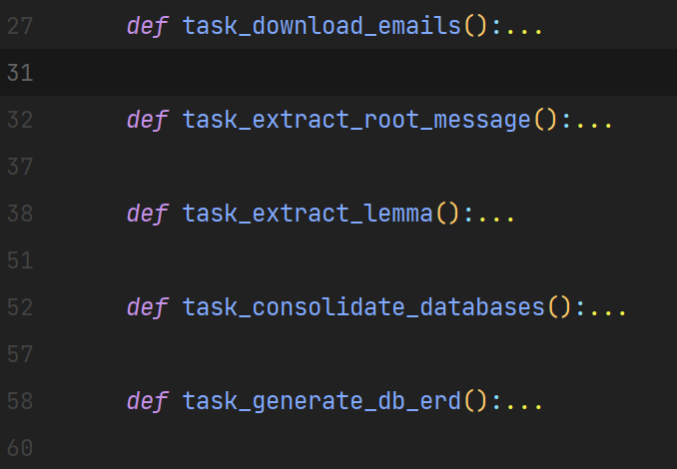
Tasks defined in this project:
<- Primary module
<- Primary module
<- Primary module
<- Utility task specific to this project
<- Utility task specific to this project

